Slide 2
Interesting facts of study in
Mauritius
*It will take ~ 6 hours, 38 minutes to travel from India to Mauritius by flight.
*It enjoys a strategic location and is well-connected by flights across Europe, Africa, Asia and Australia, Mauritius, officially known as the Republic of Mauritius, is an island nation in the Indian Ocean
*The weather is pleasant in Mauritius. So you don’t have to carry a huge bag with winter clothing when you study abroad. The temperature ranges between 25 °to 30 °C.
*In Mauritius, students are allowed to work for a maximum of 20 hours per week. In this case, work permits are not required, so they would have no complications in getting a job.
*English is the official language of Mauritius but French is also widely spoken. Most Mauritians are multilingual, speaking English, French, and Creole.

Slide 3
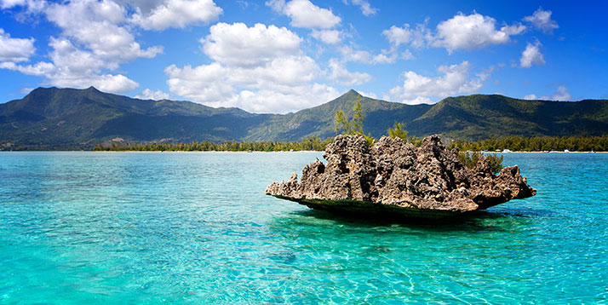
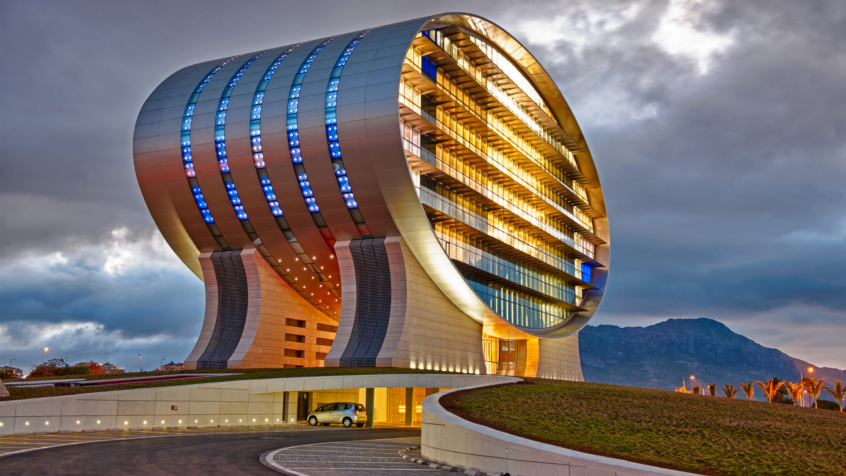
Quatre Bornes
Stephen Business School is strategically located in the town of Quarter Bornes, Mauritius
Mauritius, a peaceful and economically stable island known for its beaches, lagoons and reefs!

Slide 4
Why Stephen Business School?
We are registered with the Mauritius Qualification Authority (MQA).
We are working with two of the best awarding bodies; NCC (National Computing Centre UK), TQUK (Training Qualifications UK)
Qualifications are worldwide recognized.

Slide 5
Courses on Offer
Courses Available :
Diploma in Computing
Diploma in Computing with Business
Diploma in Hospitality and tourism management
Diploma in Business Management

Slide 6
Requirements
No IELTS or TOEFL evaluation required.
Equivalent of SC (School Certificate secondary qualification) with work experience.
Equivalent of HSC (Higher School Certificate)
Gap Accepted .

Slide 7
Why study with US
The system as a whole offers excellent programmes at all levels and in many disciplines. Students can study at Mauritius and enjoy the benefits of UK
Affordable fees.
Free student visa.
Excellent success rate.
Free student counseling and guidance to pathway programs
Flexible work and learn time table.
First work placement opportunity by college within 4 to 6 weeks of arrival
Appropriate accommodation.
Airport welcome and pick up.
Extracurricular activities e.g. outings, workshops, industry visits, festival celebrations, team building!
Mauritius has a temperate climate with two main seasons. In summer the temperature varies between 25ºC and 33ºC. Winter temperatures range from 15ºC to 24ºC.

Slide 8
Pathway Program
Stephen Business School Mauritius is glad to announce our pathway collaboration with CASS EUROPEAN INSTITUTE OF MANAGEMENT STUDIES, Paris and Global College Malta Kindly note this is an opportunity for our student who will complete level 4 or level 5 with us or both and wish to continue their academics towards bachelor, kindly go through the website of our pathway Institutions at Paris and Malta .
https://cass.edu.eu/our-programs
https://gcmalta.com/
Simultaneously our awarding body NCC has agreements and recognitions with over 80 universities and institutes in many countries Japan, UK, Canada , Australia, USA , Europe.
Other awarding body TQUK Qualifications Recognized For Progression to University of Sunderland, in Business Administration & Management and Hospitality & Catering sectors are now articulated to University of Sunderland (UoS) programs.

Slide 9
Pathway Program

Slide 10
Pathway Program

Slide 11
Pathway Program

Slide 12
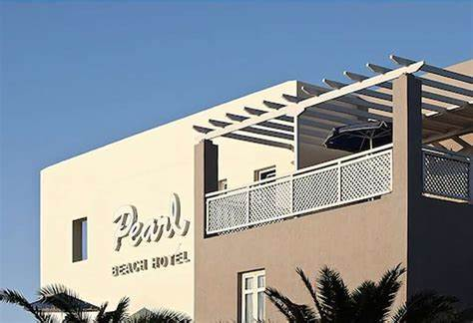
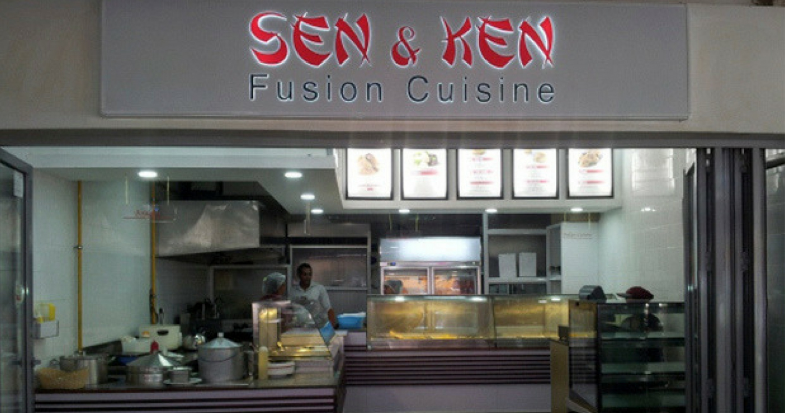
Our partnered employer

Slide 14
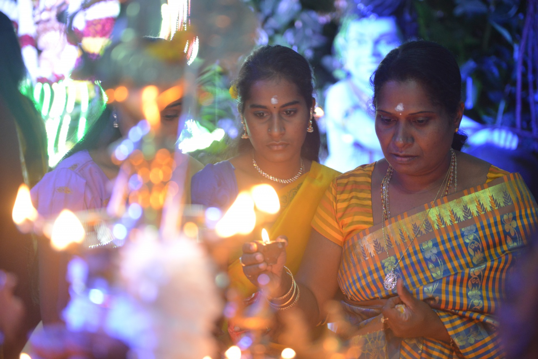
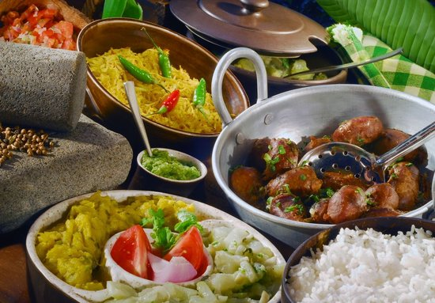
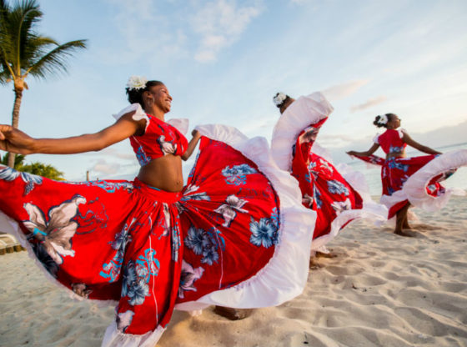
Culture
You will feel at home … The Mauritian culture is a melting pot of different religions and traditions .We celebrate all hindu and muslim, buddhists rituals.

Slide 15
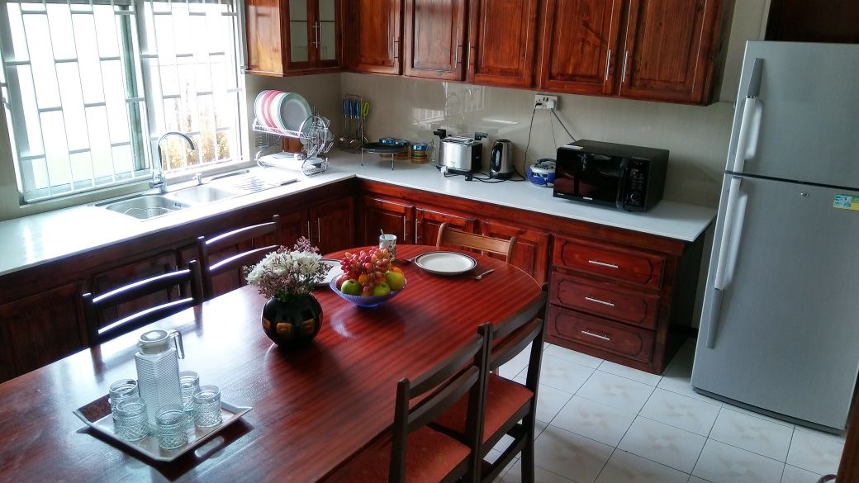
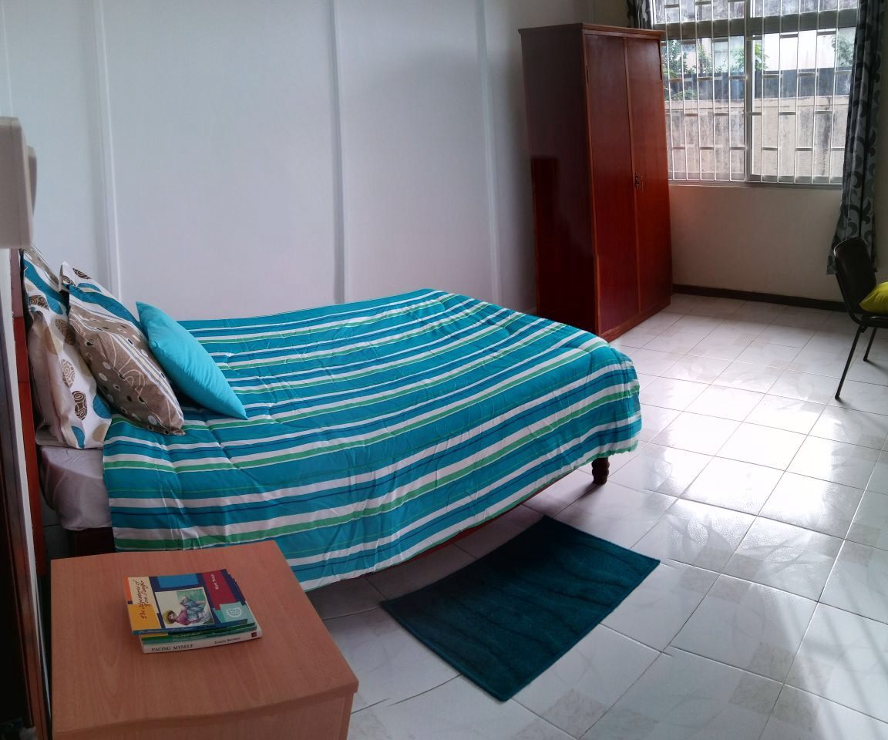
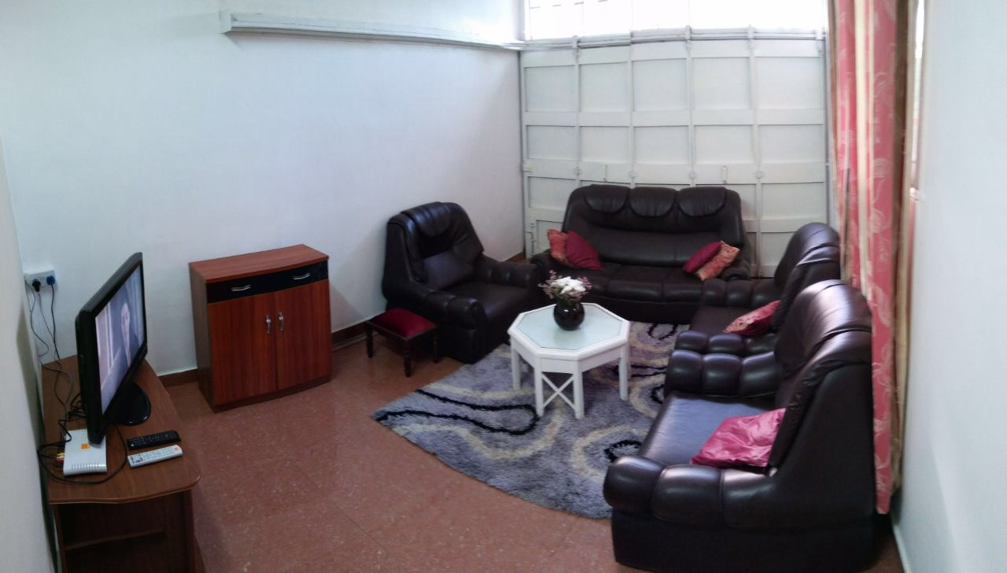
Accommodation

Slide 16
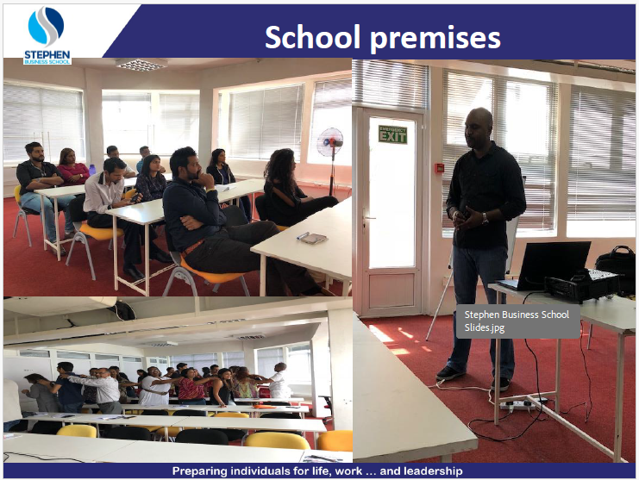

Slide 17
REQUIRMENTS
Application to enter Mauritius" form duly filled and signed by applicant (Original)
Two passport size photograph (Original)
Photocopy of bio data page of passport valid beyond stay
Letter of acceptance from student (Original)
Duly signed & sealed covering letter stating duration & course start date from institution or educational establishment (Original)
Bank statement (last 6 months) (Original) plus (+) Copy of ID passport from parents or guardian Letter of sponsorship from parents or guardian
Medical Certificate from Country of Origin
* HIV (Original)
* Hepatitis B (Original)
* Chest X-R
* PCC

